Slide 1
PID Controller Design and Tuning
Presented by Joseph Driscoll and Isaac Hill

Slide 2
Problem and Requirements
Design a “good” motor controller
5% steady state error
< 10% overshoot
Closed loop response 50% faster than open loop

Slide 3
Solution
Use PID controller
The PID controller has three variables that can be altered to control overshoot and response time (?)
[More reasons we chose a PID controller]

Slide 4
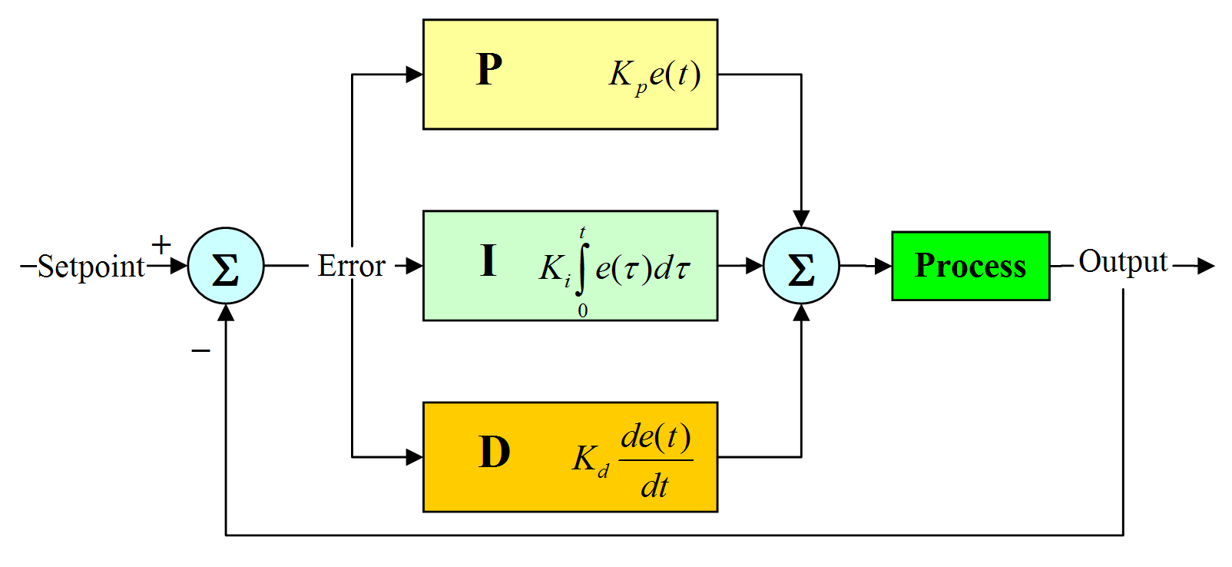
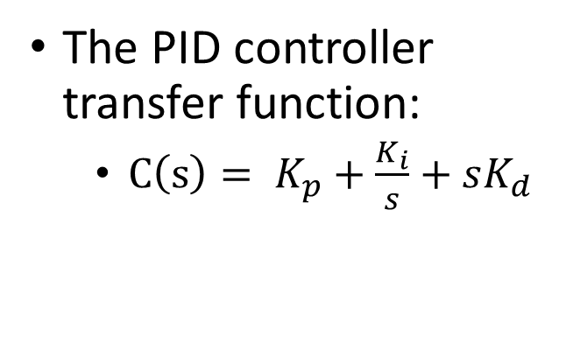
PID Controller
PID controller design:
proportional gain (K_{p})
integral gain (K_{i})
derivative gain (K_{d})
The PID controller transfer function:
$C\left(s\right)= K_{p}+\frac{K_{i}}{s}+sK_{d}$
https://nicisdigital.wordpress.com/2011/06/27/proportional-integral-derivative-pid-controller/

Slide 5
PID Controller Operation
Proportional gain – sensitivity to error
Integral gain – reduces set-point error
Derivative gain – improve settling time and stability

Slide 6
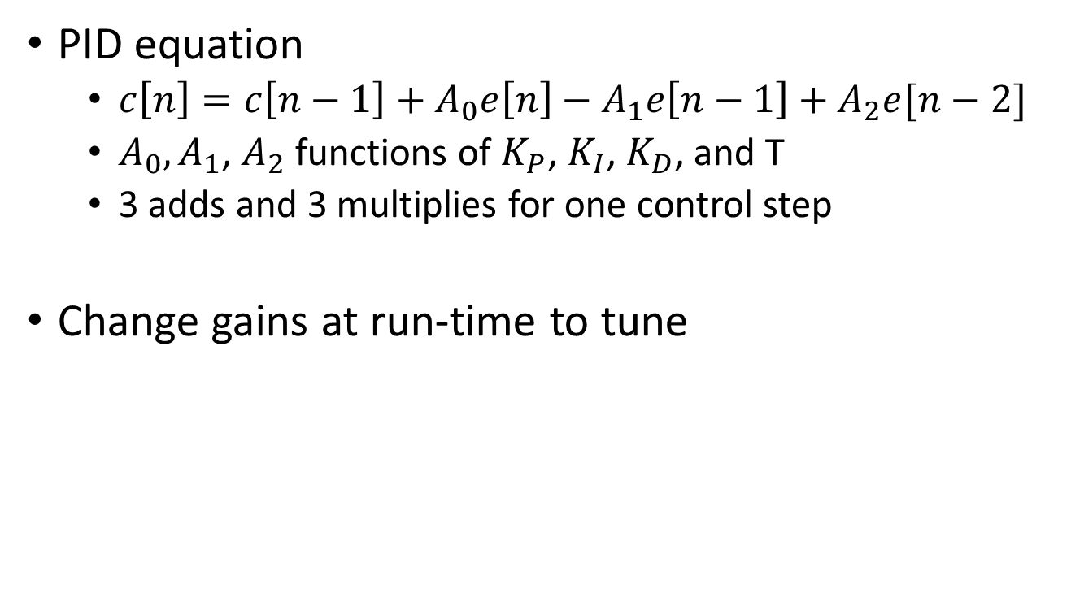
Discrete PID Equations
PID equation
$c\left[n\right]=c\left[n−1\right]+A_{0}e\left[n\right]−A_{1}e\left[n−1\right]+A_{2}e[n−2]$
$A_{0},A_{1}$, $A_{2}$ functions of $K_{P}$, $K_{I}$, $K_{D}$, and T
3 adds and 3 multiplies for one control step
Change gains at run-time to tune

Slide 7

Tuning Results
Tuning resulted in PI controller
$K_{P}=20,000$
$K_{I}=800,000$
$K_{D}=0$
Unexpectedly large gains

Slide 8
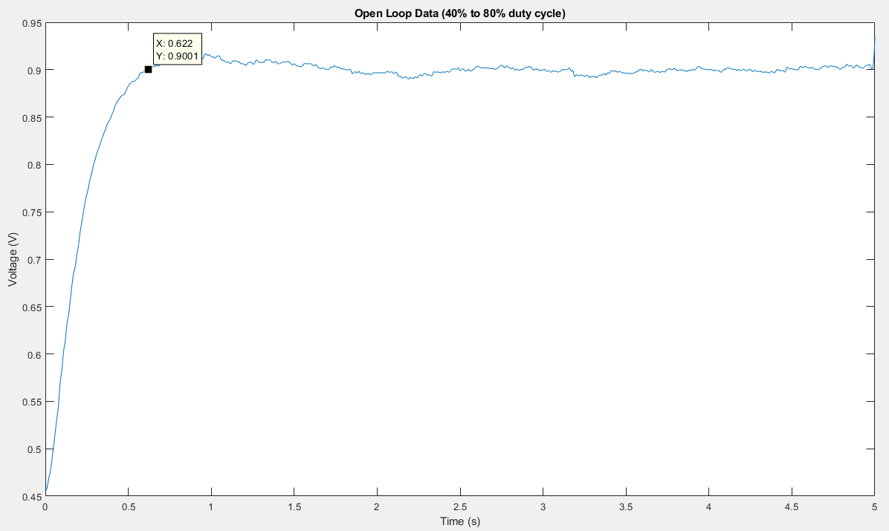
Open Loop Captured Data
622 ms

Slide 9
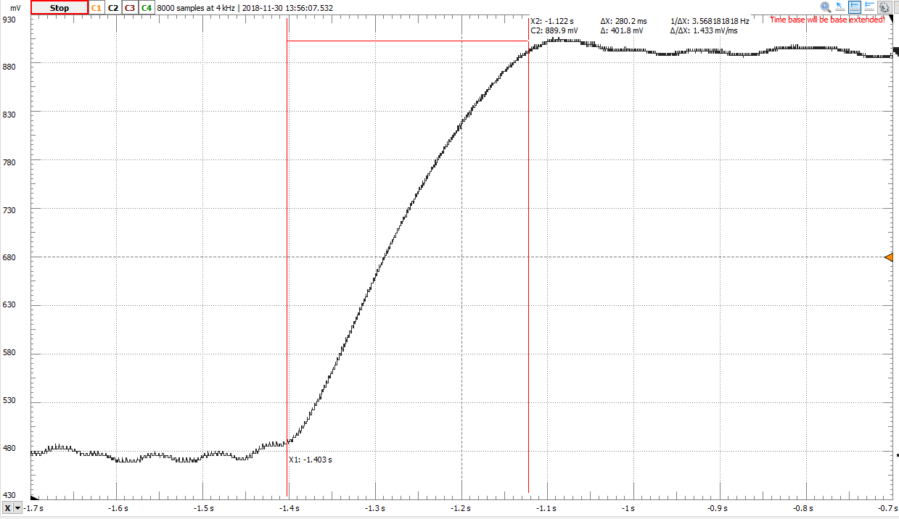
Closed Loop Captured Data
280.2 ms

Slide 10
Closed Loop Response Summary
Same transition from 480 mV to 900 mV
Settling time: 280-300 ms (~50% faster)
Minimal ripple: under 10 mV

Slide 11
PID Program

